Slide 1
Cell Division in Bacteria

Slide 2
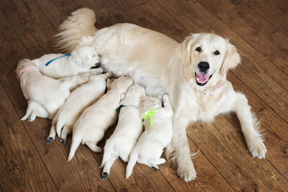

In this Smart Lesson, you will be doing the following:
1. | Naming the process that bacteria use to reproduce.
2. | Describing the process of binary fission.
3. | Explaining why cell division is needed in order for bacteria to survive.

Slide 3
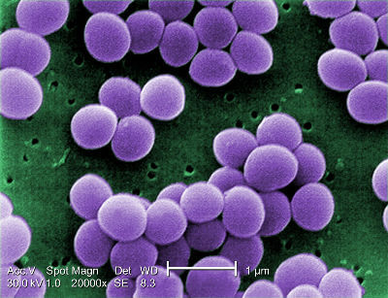
Unicellular organisms, like bacteria or other organisms found in pond water, remain as one single cell their entire lives.
They don't need cell division for things like growth and repair because their whole "body" is just one cell! The only reason bacteria use cell division is for reproduction (producing offspring).

Slide 4
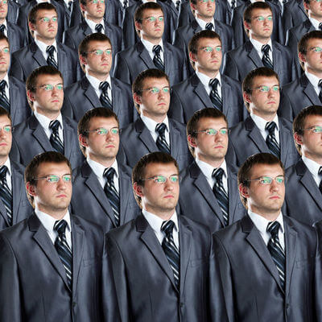
Bacteria reproduce by splitting themselves in half!
The two new cells that are produced from one bacterial cell are identical to each other and to the original cell. They are called clones.

Slide 5
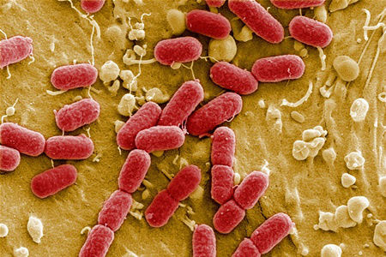
Some bacteria can reproduce every 30 minutes.
To put this into perspective, if you started with one bacterial cell on a table, after 24 hours there would be (281, 474, 976, 710, 656) bacterial cells! These cells would all be identical to each other.

Slide 6
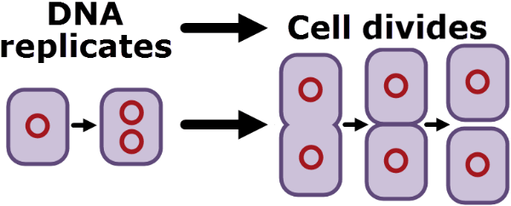
Bacterial cells reproduce through binary fission.
Binary fission is the process by which one bacterial cell splits into two identical cells.
This is similar to the process of mitosis in eukaryotic cells, but is much less complicated. There are fewer steps involved in binary fission compared to mitosis.

Slide 7
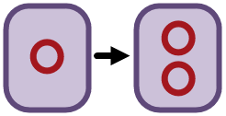
Remember that bacteria and other prokaryotic cells have only one circular chromosome of DNA, and it is not contained in a nucleus.
This means that cell division is simpler in bacteria than in eukaryotic cells. The first step of binary fission is to copy the DNA, so that each new cell gets a full copy of the genetic material.

Slide 8
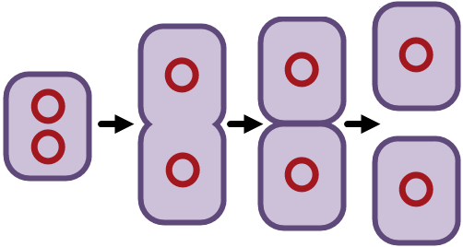
After copying the DNA, the bacterial cell grows larger, and the two copies of the DNA move to opposite ends of the cell.
The cytoplasm, cell membrane and cell wall divide down the middle, splitting the original cell into two new cells. The new cells are identical to the original cell. They are called clones.

Slide 9
Here is a summary of the main steps in binary fission:
1. | Bacteria DNA is organised into one circular chromosome and is not contained in a nucleus.
2. | The DNA is copied, so the cell now has two full copies of DNA.
3. | The cell grows larger, and one copy of the DNA moves to each side of the cell.
4. | The cell divides into two.
5. | The two new cells are genetically identical to the original cell.

